Slide 1

PREDICTING CUSTOMER BUYING BEHAVIOUR
25/08/2023

Slide 2
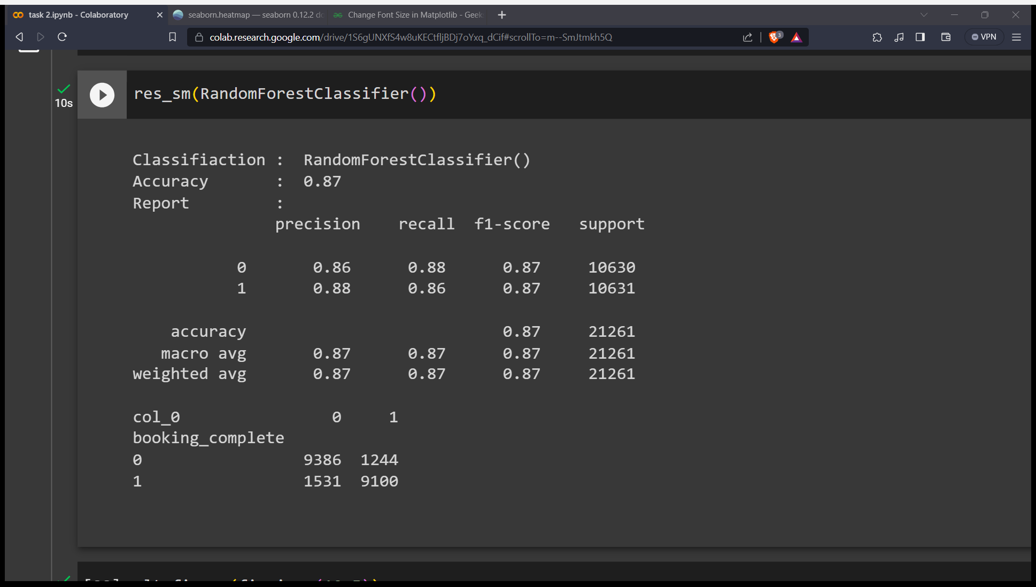
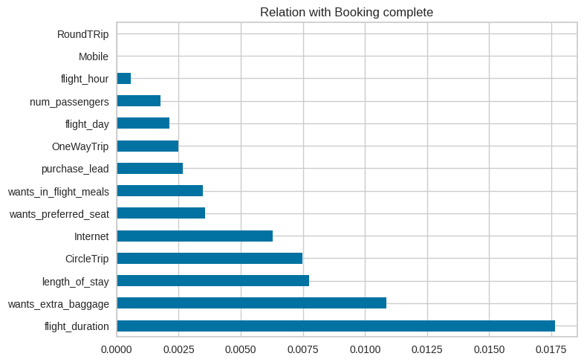
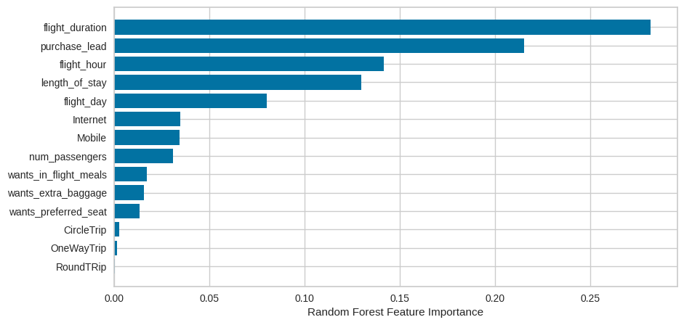
Model Summery and Metrices
Data was trained with Random forest classifier model and achieved accuracy is 87%
Top 5 features which influence Customer buying behavior are flight_duration, wants_extra_baggage, length_of_stay, purchase_lead, flight_hour.

